Slide 1

Topics
•
•
Catching Exceptions
try
{
..
}
catch
()
{
..
}
1
Object-Oriented Programming Using Java

Slide 2
Exception Handling
•
1.
Exception Handling Requires Four Steps
Finding the Problem→ Identify the Statements Which May Result in Exception. Put all those statements in a try {..} block.
Inform that an Exception is thrown (Throw the Exception)
2.
<<
Note
Down
the difference
between
throw vs
throws
clauses>>
Catch the Exception Using catch(
Provide the Exception Handling
blocks
3.
4.
.. ) statements
Code in catch(
..
) { .. }
2
Object-Oriented Programming Using Java

Slide 3
Exception
Handling
Syntax
try
{
<statements that can throw exceptions>
}
Important Points :
1.
try { .. } block may have one or
multiple statements.
2.
try { ..
either
type
} block may be capable of
throwing
either
a
single
catch(Exception-Type-1 e1)
{….}
or
multiple
types
of
exceptions.
There can be multiple catch() { ..
catch(Exception-Type-2 e2)
{….}
3.
}
blocks
associated
with
single
catch(Exception-Type-3 e3)
{….}
try { .. } block.
If try{} block can throw multiple
………………………………..
4.
exceptions
then
user
should
catch(Exception-Type-N e4)
{….}
catch all exceptions. (one catch
block for each type of exception)
3
Object-Oriented Programming Using Java

Slide 4
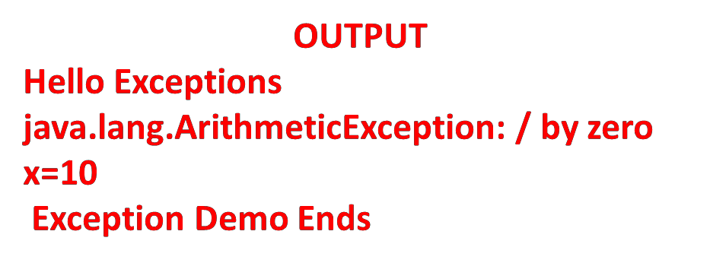
Catching an Exception :
Example 1
class
{
ExceptionDemoTest
public static void main(String args[])
{
System.out.println(" Hello Exceptions");
int d = 0;
int x = 10;
try
{
x = 42 / d;
}
catch(ArithmeticException e) { System.out.println(e);
System.out.println("x=" +x); System.out.println(" Exception Demo Ends");
}// End of Method
}// End of class
}
4
Object-Oriented Programming Using Java

Slide 5
Catching Multiple Exceptions
Example
class ExceptionDemoTest
{
public static void main(String args[])
{
int a[]= {5,10};
try
{
int b= Integer.parseInt(args[0]);
int x = a[b]/(b-a[1]);
System.out.println("x="+x);
}
catch(ArithmeticException e)
{ System.out.println(e); }
catch(NumberFormatException e) { System.out.println(e); }
catch(ArrayIndexOutOfBoundsException e) { System.out.println(e);}
System.out.println("Exception Demo Ends");
}// End of Method
5 }//OEbnjecdt-Oorifenctelad Psrsogramming Using Java

Slide 6
Catching Multiple Exceptions
Example …
java ExceptionDemoTest
java.lang.ArrayIndexOutOfBoundsException:
0
Exception
Demo
Ends
java ExceptionDemoTest
0
x=0
Exception
Demo
Ends
java ExceptionDemoTest
1
x=-1
Exception
Demo
Ends
java ExceptionDemoTest
a
java.lang.NumberFormatException: For input
Exception Demo Ends
string:
"a"
6
Object-Oriented Programming Using Java

Slide 7
Nested Try Statements
•
Try{ } statements can be nested. One try block may contain
another try block
In case of nested try blocks, context of that exception is pushed onto stack.
Inner try block may/or may not have catch statements
associated with it.
If an exception is thrown from inner try block then first inner catch statements are matched (if present) . If no match is found then outer try block are matched. If there also no match found then default handler will be invoked.
However, if outer try block throws the exception then only outer try blocks are matched.
•
•
•
•
7
Object-Oriented Programming Using Java

Slide 8
Nested try statements
A Typical Syntax
:
try
{
Statement- A; Statement-B;
try
{
Statement-C; Statement-D;
}
catch(CException e) {
catch(DException e) {
}
catch(AException e) { ….
catch(BException e) { ….
try
{
Statement-A; Statement-B; try
{
Statement-C; Statement-D;
}
}
catch(AException e) { catch(BException e) { catch(CException e) { catch(DException e) {
….
….
}
}
….
….
….
….
}
}
}
}
}
}
8
Object-Oriented Programming Using Java

Slide 9
Nested try statements
A Typical Syntax …
:
try
{
Statement-A; Statement-B; try
{
Statement-C;
Statement-D;
}
catch(CException e) {
catch(DException e) {
}
….
….
}
}
catch(AException e) {
catch(BException e) { catch(CException e) { catch(DException e) {
….
….
….
….
}
}
}
}
9
Object-Oriented Programming Using Java

Slide 10
Nested try { .. } : Example
class nestedtry
{
public static void main(String args[])
{
int a[]
try
{
=
{ 2,5,6};
// outer try
// { a[0] = 2, a[1]
= 5, a[2] = 6}
int b = Integer.parseInt(args[0]);
try
{
// inner try
int c[] = { 4,5,6};
// { c[0] = 4, c[1] = 5,
c[2] = 6}
int d = c[b]/(c[b]-4);
} // End of inner try
// catch Blocks Associated With Inner Try Block catch(ArrayIndexOutOfBoundsException e)
{
System.out.println("Exception : "+ e.toString());
System.out.println("By Inner try");
}
10
Object-Oriented Programming Using Java

Slide 11
Nested try { .. } : Example …
catch(ArithmeticException e)
{
System.out.println("Exception : "+ e.toString());
System.out.println("By Inner try");
}
} // End of outer try
// Catch Blocks Asscoiated With Outer try Block
catch(ArrayIndexOutOfBoundsException e)
{
System.out.println("Exception : "+ e.toString());
System.out.println("By Outr try");
}
catch(NumberFormatException e)
{
System.out.println("Exception : "+ e.toString());
System.out.println("By Outer try");
}
} // End of main
11 }Obje/ct/-Ori^{E}en^{n}te^{d}d Prºg^{f}ramm^{c}i^{l}ngªU^{s}si^{s}ng Java

Slide 12
Nested try { .. } : Example …
java nestedtry
Exception : java.lang.ArrayIndexOutOfBoundsException:
By Outer try
0
java nestedtry 4
Exception : java.lang.ArrayIndexOutOfBoundsException:
By Inner try
4
java nestedtry 0
Exception : java.lang.ArithmeticException: / by zero
By Inner try
12
Object-Oriented Programming Using Java

Slide 13
Thank
You
13
Object-Oriented Programming Using Java

